Slide 1

INFM 600: Information Environments
Week 5 - Wed Sept 28 & Thurs Sept 29, 2016:
Organizing Information
Dr. Andrea Wiggins | Jonathan Brier
Notes:
Happy to be here today with you—thank you for being here today too
Excited to teach class again, really enjoyed it last year and it should be even better this time.
We’ll be spending too much time together for this class to be a drag, so let’s try to have a good time together.

Slide 2
Reading Review: Corti et al.
What are the key takeaways from this reading?
File Formats
Data Conversion
Data Transcription
Digitizing Data
Organizing Data files in Logical Manner
File Names
File Structure
Quality Assurance
Data Collection
Data Entry and Data Capture
Data Checking
Version Control and Authenticity
Notes:
What experiences have you run into where any of these have been an issue?

Slide 3
Reading Review:Vardigan et al.
Importance of Metadata
Mapping
Crosswalk
Standards
“Good documentation is paramount to effective data use” (Vardigan et al., 2008)
“The replication standard holds that sufficient information exists with which to understand, evaluate, and build upon prior work if a third party can replicate the results without any additional information from the author.” (King, 1995)

Slide 4
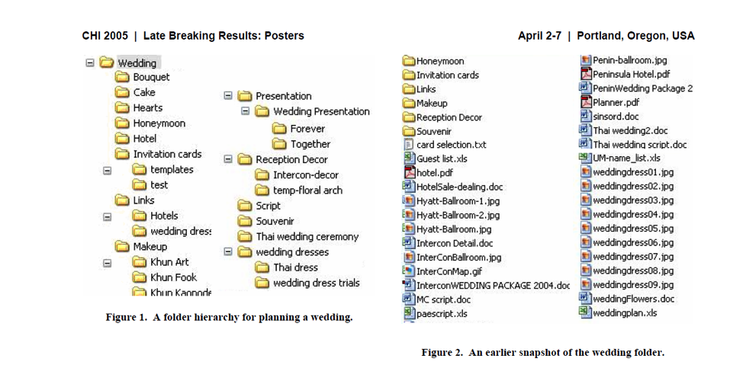
Organization

Slide 5
Organizing information
Information: that which is informative
Organize: to arrange or order things so that they can be found or used easily and quickly; to put things into a particular arrangement or order (syn.: codify, classify, systematize)
Organizing information: arranging or applying order to information
Notes:
Many ways to organize information, many aspects of information organization – just an intro
Many aspects of info organization that could be covered! Traditionally the professional domain of librarians and info scientists, but as tech makes it easier for us to own and manage information ourselves, we are increasingly tasked with organizing information for ourselves. Probably the most familiar example for most of us is iTunes, right?
Start with some examples, first three are related

Slide 6
Organizing information
Data Structure: a particular way of organizing data in a computer so that it can be used efficiently
Metadata: “data about data”
Information Architecture: the art and science of organizing and labeling websites, intranets, online communities, and software to support usability and findability
Notes:
Main info organizing topics we’ll touch on today. Each of these has much more to it, but we can only go into a little bit of detail. These are some working definitions, there are other variations.

Slide 7
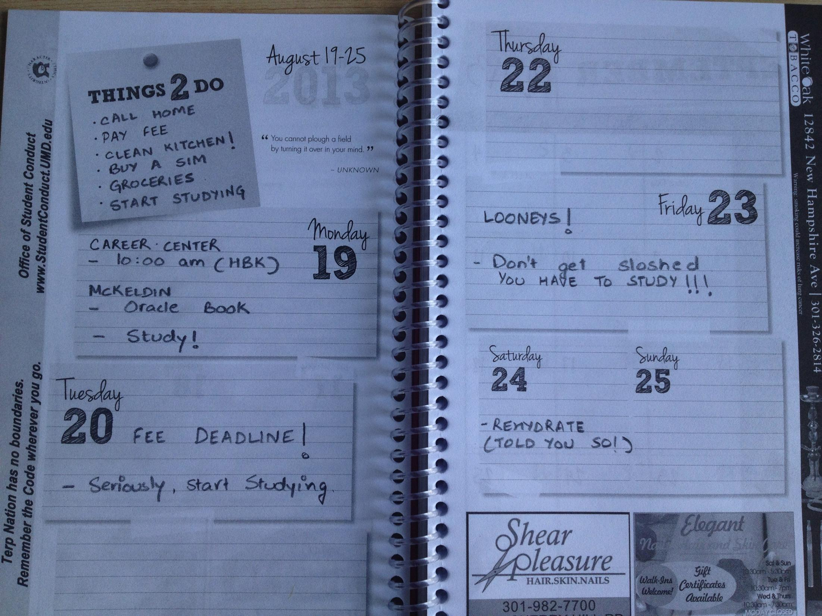
Notes:
Planner

Slide 8
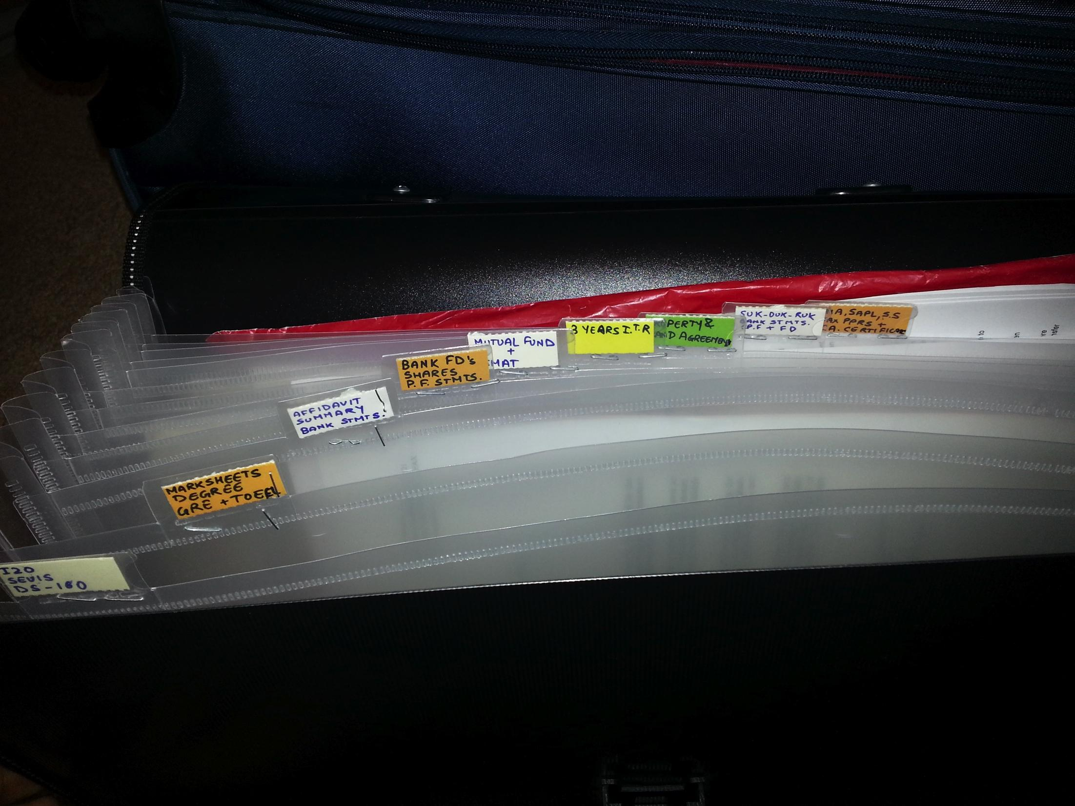
Notes:
Omkar

Slide 9
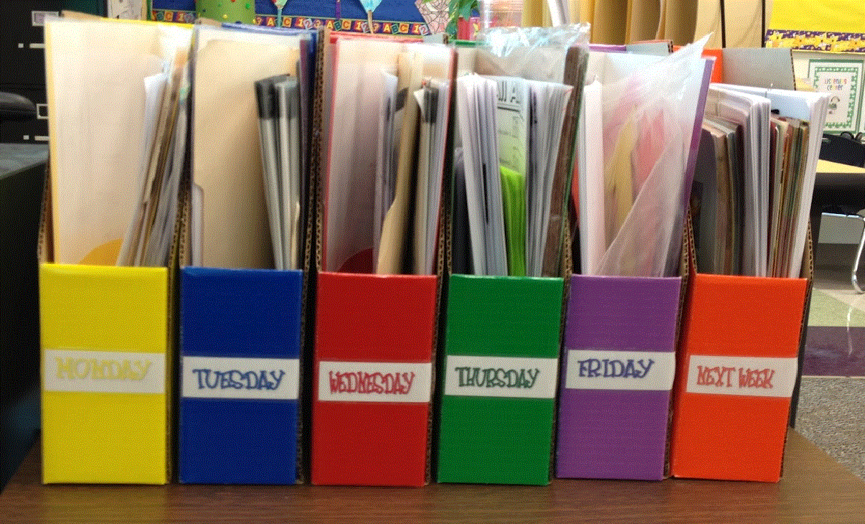
Notes:
Tanvi Nakra
So as you can see, these are all about organizing paper documents, maybe drafts of class papers, maybe information about when assignments are due. They’re also all ways to organize personal information, and sometimes also organizational information. There are also digital systems for this, right?

Slide 10
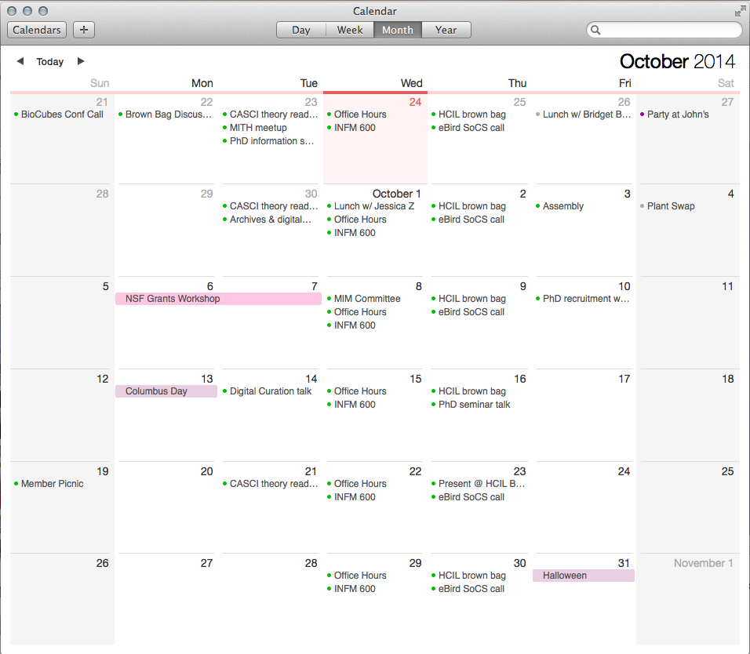
Notes:
Electronic calendars, which we rely on more and more

Slide 11
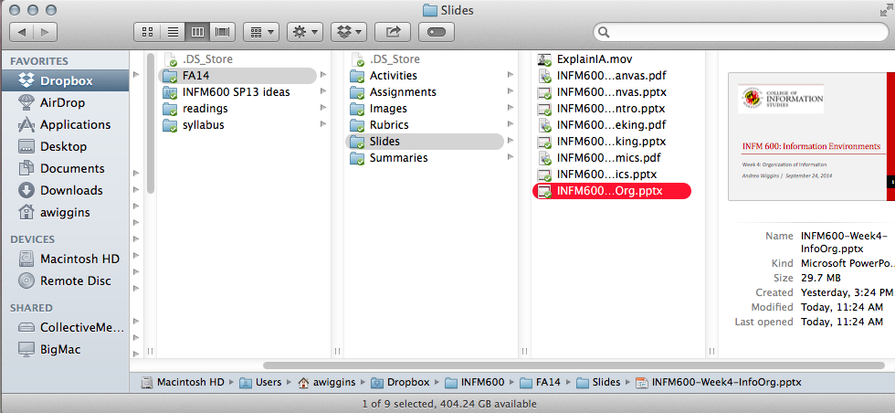
Notes:
Digital file management—many types of these now

Slide 12
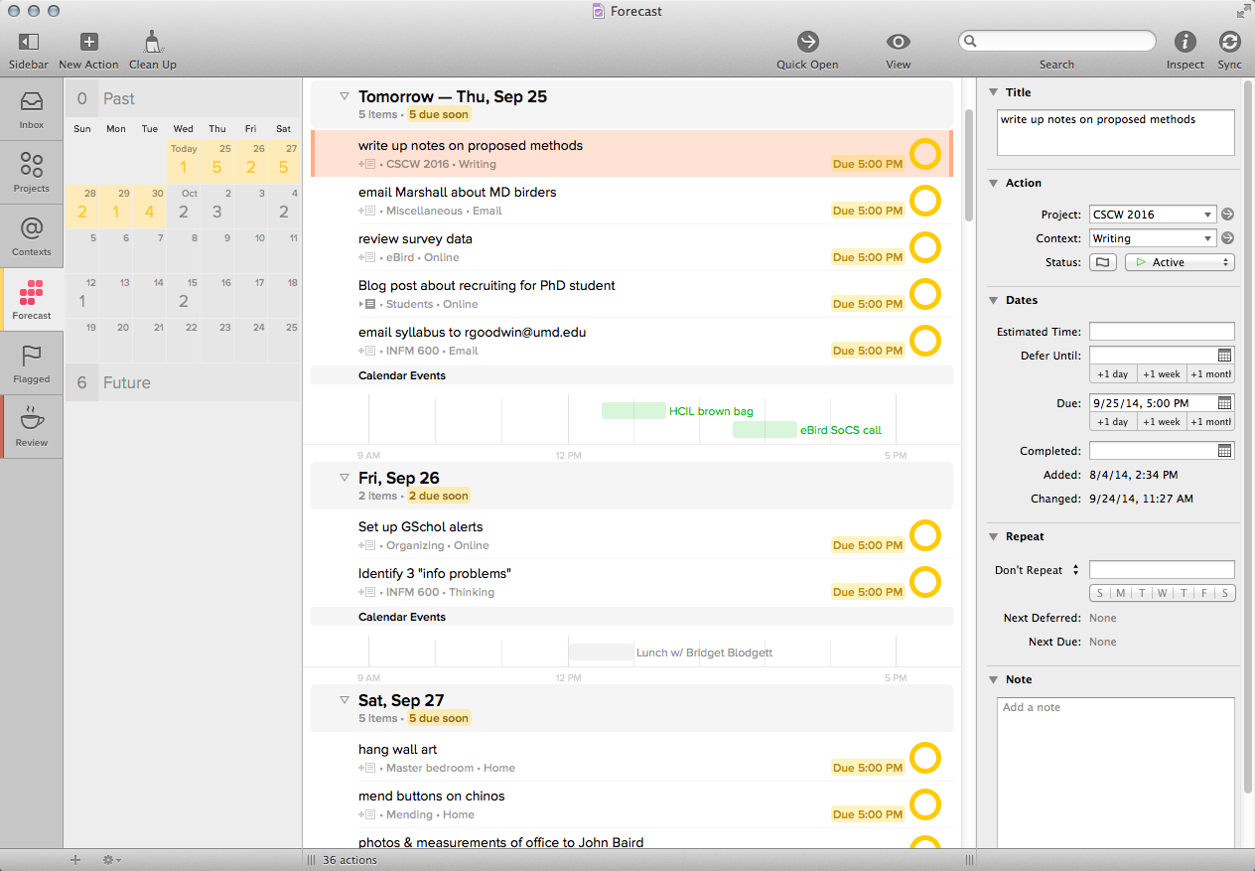
Notes:
Productivity software, keeps track of tasks and integrates calendar
But these are the more obvious types of info organizing, what most of us encounter regularly. There are other types too.

Slide 13

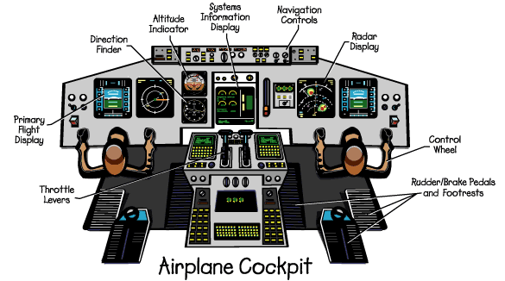
Notes:
Other ways to organize information in physical space and using a number of different displays

Slide 14
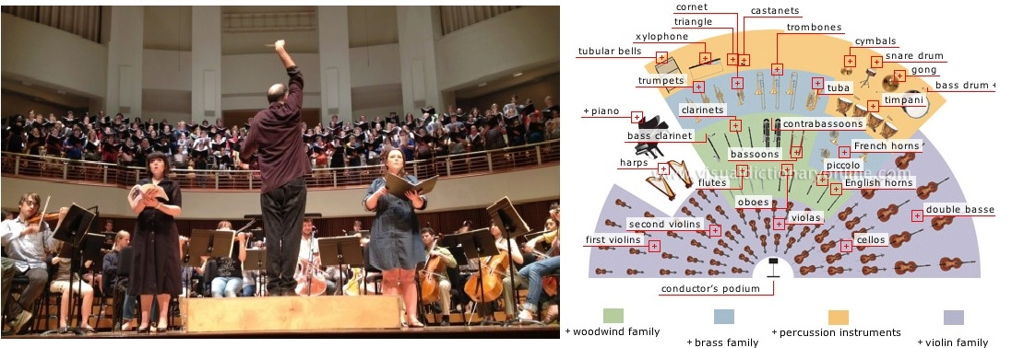
Notes:
Concert performers are organized in a specific fashion, which we can also represent visually.

Slide 15
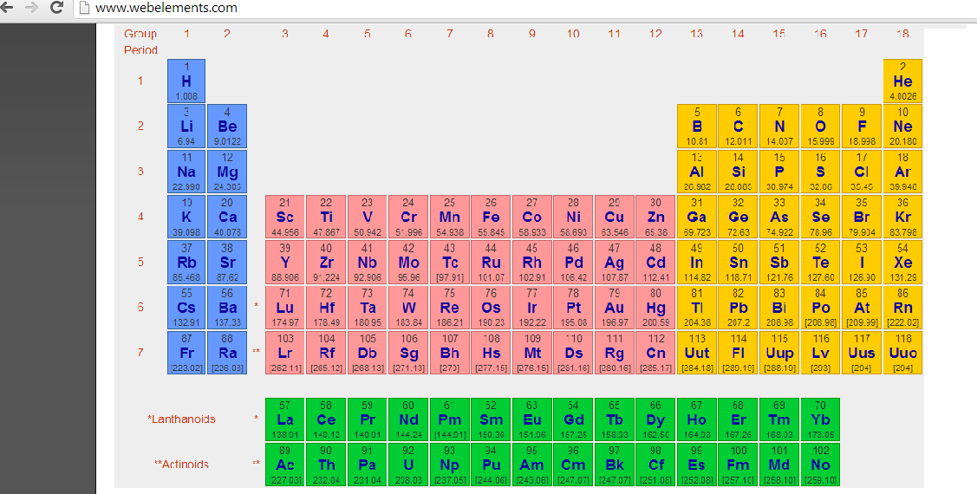
Notes:
Periodic table of elements is a classic example of info organization

Slide 16
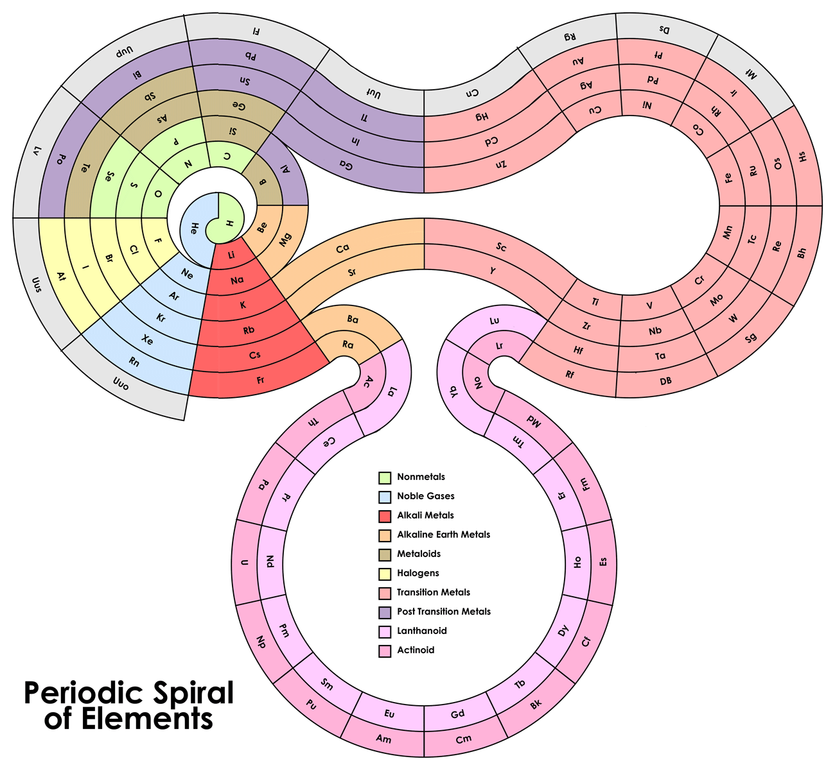
Notes:
How about this way of viewing it?

Slide 17
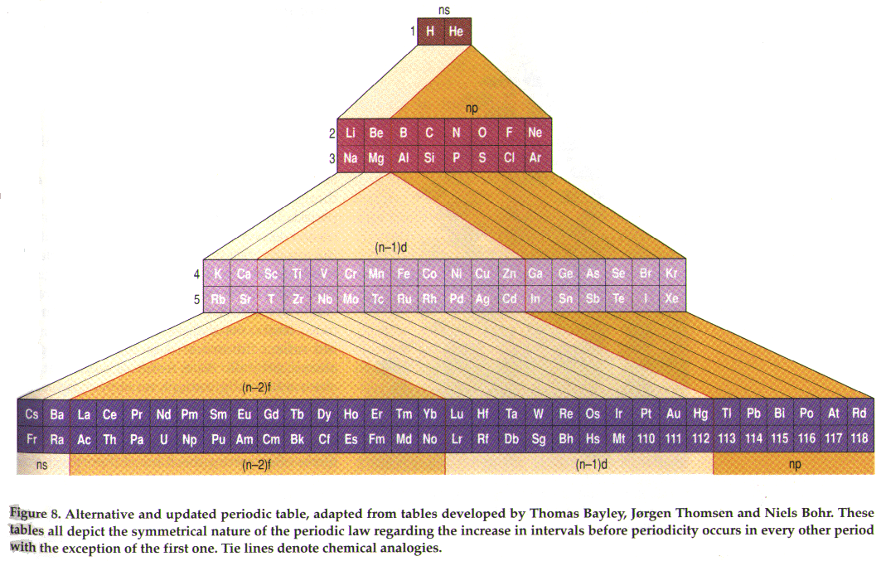
Notes:
How about this one? Each version shows a different view of some of the same information.

Slide 18
Consider...
“Every time you organize matters in one way, you are disordering them in others” (Weinberger, Everything is Miscellaneous, p. 88).
Notes:
7 PM
Ask students to talk about this quote and why they think it is important to think about from a business perspective.
Order often hides more than it reveals.
No matter what your data, you can always spin the story you want.

Slide 19
Organizing Systems
Why do we use “organizing systems”?
What kinds of things do we organize?
In information systems?
What are some examples of principles for organizing?
Collocation
Frequency of use
Color
Genetics
Organizing systems are classified by:
Type of resources they contain
Dominant purposes or priorities, e.g., “memory institutions”
Nature or size of intended user community
Technology used to implement them
Notes:
Main goal of org systems is facilitating search & retrieval
Differences in granularity of organizing
Advantages & disadvantages of classifications of org systems?

Slide 20
In Class: Demo
Using the following data what would be:
A complementary dataset?
Needed to map the complementary data?
Table 4-28 - Annual Wasted Fuel Due to Congestion (Updated January 2016)
http://www.rita.dot.gov/bts/sites/rita.dot.gov.bts/files/publications/national_transportation_statistics/index.html
Notes:
Open the dataset for viewing to the class.
Using this dataset have the students brainstorm what datasets are complementary and what they would need to align the complementary data.

Slide 21
Activity: DataOne spreadsheet
Get into groups of two and download the spreadsheets from the Module for Week 5.
In small groups, open the 3 files and inspect them. Based on what you have learned so far about data management, what are some problems in the way the data are currently organized?
Suggest a new system for organization. Create a new spreadsheet that can be used as a template for later years of data collection.
Notes:
Read background:
Plankton are microscopic organisms that form the base of many aquatic food webs – fueling the growth of fish and other larger organisms. It’s common to sample the musing a net or another container that can be controlled to collect water just from certain depths; so you can see how plankton collected at the surface (0 meters) might be different from plankton at another depth (e.g. 10 meters below the surface).
(For more information:http://en.wikipedia.org/wiki/Phytoplankton and http://en.wikipedia.org/wiki/Zooplankton.)
They are identified and counted under a microscope, andusually their numbers are reported as individuals per liter ormilliliter.
Frequently, aquatic scientists collect plankton samples during both day (e.g. noon) and night(e.g. 2 am) because plankton change their distributions from day to night, and not all species alter their distributions in the same way.
(For more information, search “diel vertical migration”on the web.)
You should have 3 (fictional) data files: pond2010.xlsx, zoop-‐‐temp-‐‐main.xlsx; zoop-‐‐temp.xlsx.
These 3 files were all intended to be part of the same study – the investigators wanted to examine the day-‐‐night distribution of 2 species of zooplankton across multiple years. The type ofzooplankton they studied is called rotifers generally, and specifically the genus Conochilus, inwhich groups of individual rotifers stick together in colonies (see http://eol.org/pages/43393/overview). The investigators plan to repeat this study for several more years.

Slide 22
Break

Slide 23
Primary components of IA
Organization Systems: How we categorize information
Labeling Systems: How we represent information
Navigation Systems: How we browse or move through information
Searching Systems: How we search information
Notes:
Lots of this traces back to librarianship, as Dan mentioned in the video. Might take these things for granted on today’s Internet, but that’s because the state of the art has developed to the point that we have the luxury of taking IA for granted as users. However, anyone producing web sites needs to make decisions about IA, about each of these types of elements, whether or not they’re doing so strategically or consciously.

Slide 24
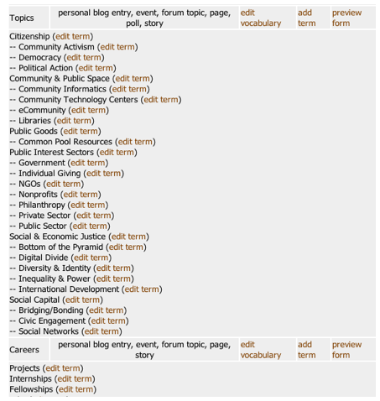
“Invisible” Components
Controlled vocabulary
Thesauri
Rule sets

Slide 25
Data Structures
Flat files
csv,tsv, xls, txt, etc.
“Matrix” formats
Databases
Relational databases (SQL)
Non-relational databases (NoSQL)
Semantic databases (RDF-S + OWL)
Notes:
The Resource Description Framework RDF is a general framework for how to describe any Internet resource such as a Web site and its content.
The OWL Web Ontology Language is designed for use by applications that need to process the content of information instead of just presenting information to humans. OWL facilitates greater machine interpretability of Web content than that supported by XML, RDF, and RDF Schema (RDF-S) by providing additional vocabulary along with a formal semantics.

Slide 26
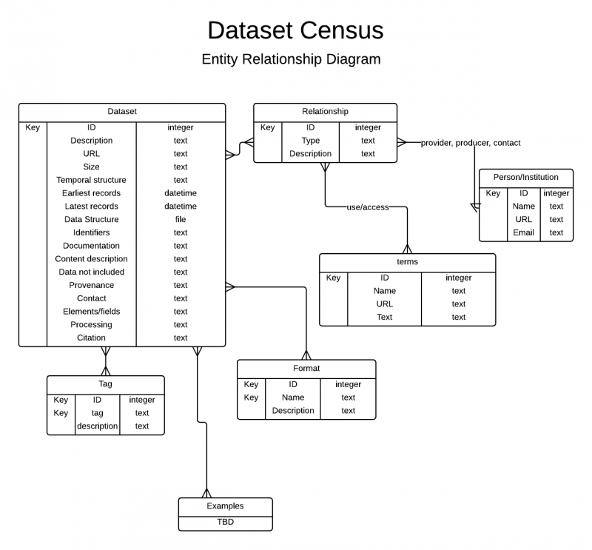
Notes:
Is everyone familiar with ERDs? data model for describing the data or information aspects of a business domain or its process requirements, in an abstract way that lends itself to ultimately being implemented in a database such as a relational database. The main components of ER models are entities (things) and the relationships that can exist among them, and databases.
So here’s an ERD, documents the data structure for the wiki. Shows the types of relationships (many to many) between tables, the data fields in each table, the type of data in each field
So the data structure may have changed since this ERD was created, but it still gives us a fair idea of what goes into each record. What else can we observe about the data structure here?
-relationship types
-terms of use/access
-tags for tagging content so that there’s another way to find it
-Examples table: shows vision for future development of the resource by including examples from the data sets

Slide 27
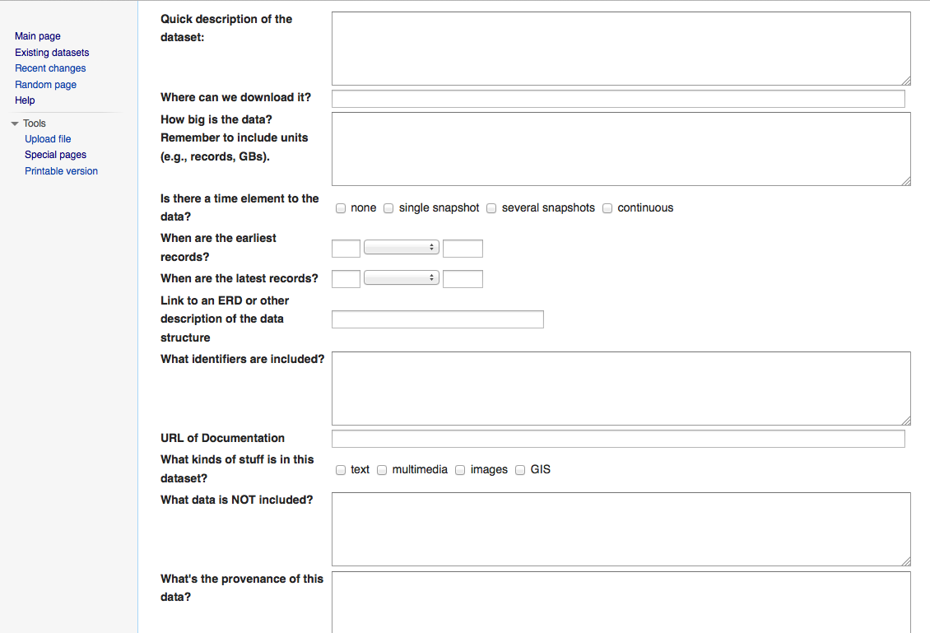
Notes:
Here’s part of the web form for the dataset census. So we can see that some of the fields on the ERD are shown here: for example, earliest records and latest records. But some things on the form are not in the ERD: for example, the categorical answers to the checkboxes are usually encoded with the actual values stored in a separate table and retrieved as needed. That way you can change the categories without revising every single record individually.

Slide 28
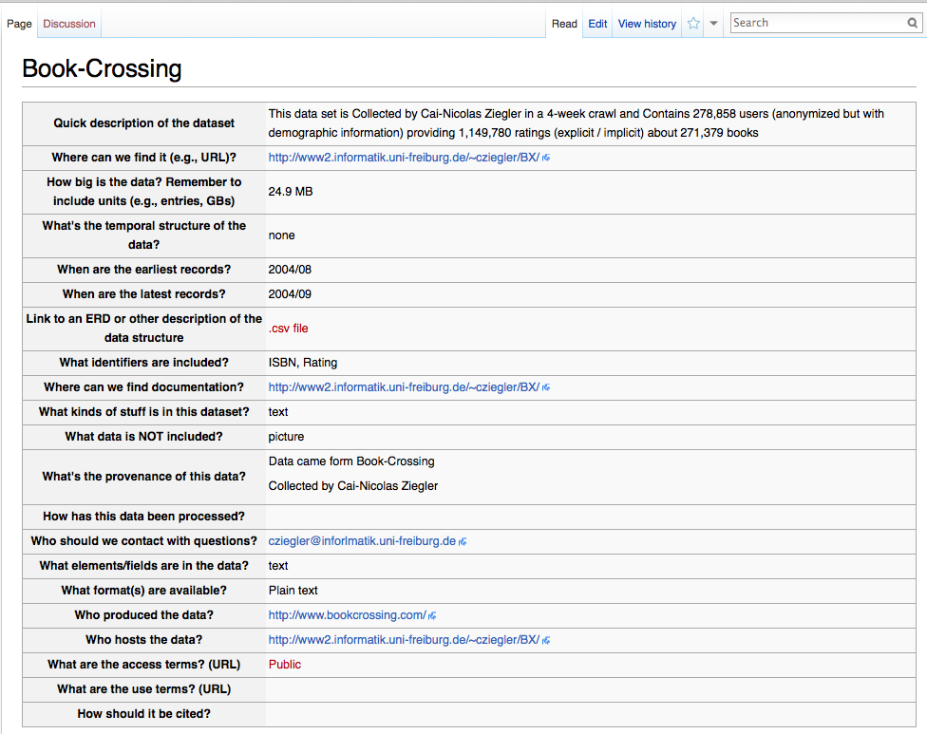

Slide 29
What is metadata?
“data about data” or “data reporting”
WHO created the data?
WHAT is the content of the data?
WHEN were the data created?
WHERE is it geographically?
HOW were the data developed?
WHY were the data developed?
Notes:
main purpose of metadata is to facilitate in the discovery of relevant information, aka resource discovery. Metadata also helps organize electronic resources, provide digital identification, and helps support archiving and preservation of the resource.
Structural metadata: data about containers for data
Descriptive metadata: data about individual instances of data, the data content itself
Examples in a moment
Standards help us actually use metadata; if we standardize, we can use info retrieval tools. There are many relevant standards, and which ones depends on the nature of the work, i.e. W3C standards versus DarwinCore. A couple examples of high-level standards related to metadata include XML schema documents and ontologies, which are not themselves standards but use a standardized vocabulary and grammar to power semantic technologies.
Provenance is another important concept with metadata because metadata helps us retain provenance about data, which is increasingly important. More emphasis in sciences than elsewhere, but if your business could conceivably be audited, then the provenance of your digital records could become important.

Slide 30
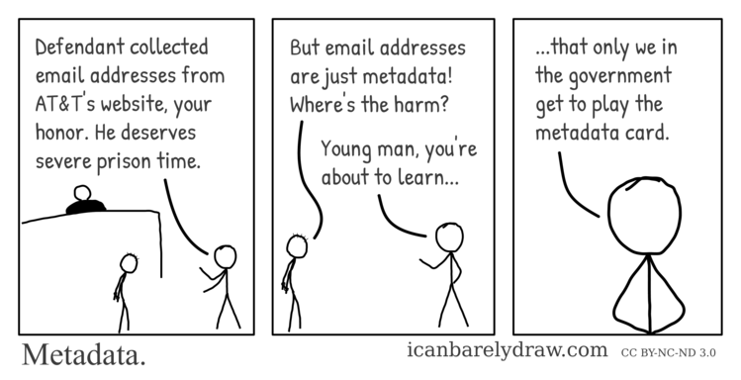
Metadata

Slide 31
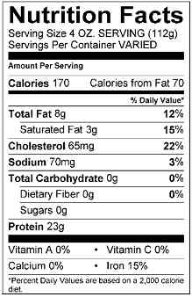
Metadata IRL
Author(s) Boullosa, Carmen.
Title(s) They're cows, we're pigs /
by Carmen Boullosa
Place New York : Grove Press, 1997.
Physical Descr viii, 180 p ; 22 cm.
Subject(s) Pirates Caribbean Area Fiction.
Format Fiction

Slide 32
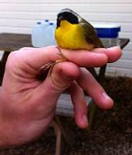
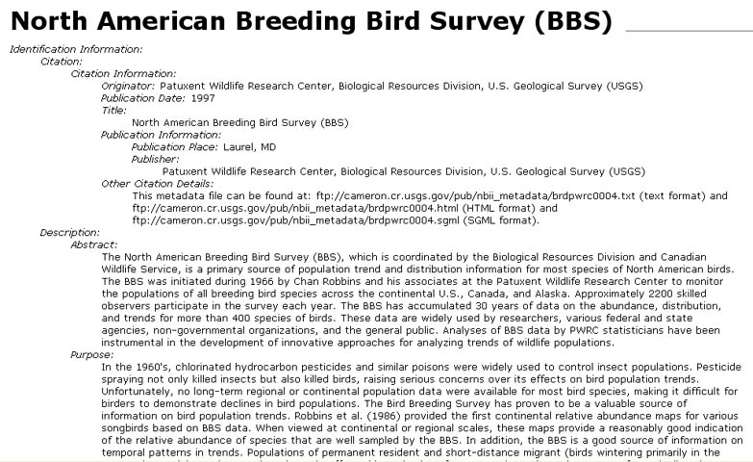
Example metadata record

Slide 33
Issues creating metadata
Even if we know it’s valuable…
Most people don’t know how
Have to find & apply the right standard/s
Tools are domain-specific
It’s “extra” work
Not directly rewarded

Slide 34
Fixing metadata creation issues
Concern | Solution
workload required to capture accurate robust metadata | incorporate metadata creation into data development process – distribute the effort
time and resources to create, manage, and maintain metadata | include in grant budget and schedule
readability / usability of metadata | use a standardized metadata format
discipline specific information and ontologies | ‘profile’ standard to require specific information and use specific values

Slide 35
Value of Metadata
Data
developers
Data
users
Metadata
helps…
Organizations

Slide 36

Value to…Data developers
Metadata allows data developers/creators to
Avoid data duplication
Share reliable information
Publicize efforts – promote the work and contributions to a field of study or practice
CC image by US Embassy Guyana on Flickr

Slide 37

Value to…Data consumers/users
With metadata, users can:
Search, retrieve, and evaluate data set information from both inside and outside an organization
Find data: Determine what data exists for a geographic location and/or topic
Determine applicability: Decide if a data set meets a particular need
Discover how to acquire the dataset you identified; process and use the dataset
CC image by ASEE on Flickr

Slide 38

Value to…Organizations
Metadata helps ensure an organization’s investment in data:
Documentation of data processing steps, quality control, definitions, data uses, and restrictions
Ability to use data after initial intended purpose
Transcends people and time:
Offers data permanence
Creates institutional memory
Advertises organization’s work:
Potential for new partnerships and collaborations through data sharing
CC image by mambol on Flickr

Slide 39
Information Entropy
Time of data development
Specific details about problems with individual items or specific dates are lost relatively rapidly
General details about datasets are lost through time
DATA DETAILS
Retirement or career change makes access to “mental storage” difficult or unlikely
Accident or technology change may make data unusable
Loss of data developer leads to loss of remaining information
TIME
(From Michener et al 1997)
Notes:
This graph illustrates the phenomenon of “information entropy”, associated with research. At the time of the research project, a scientists memory is fresh. Details about the development of the dataset are easily recalled, and it is a good time to document information about the process. Over time, memory of the details begins to fade. A variety of circumstances can intervene, and eventually detailed knowledge about the dataset fades. Without a metadata record, this data might be unusable. A dataset it not considered complete without a metadata record to accompany it.

Slide 40
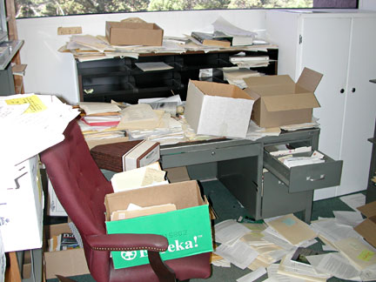
Information Entropy
Sound information management, including metadata development, can arrest the loss of dataset detail.
DATA DETAILS
TIME
Notes:
Sound data management is best achieved with making metadata creation a part of the workflow. Not only can it keep the individual scientist organized, but the data has a much better chance of being re-used by future scientists.

Slide 41
Metadata supports discovery
keywords
geographic location
time period
attributes
IDENTIFY
use constraints
access constraints
data quality
availability/pricing
ASSESS
online access
order process
contacts
ACCESS
Notes:
Metadata serves data discovery at multiple levels:
initial identification by query of keywords, location, time, and attributes
a quick assessment can be made by the scientist as to how useful the data is for a project by reading the access and use constraints; data quality measures of positional and attribute accuracy and sources used; and statements as to data availability, format and pricing
a user can find out how to access the by reading access instructions, any standard order process instructions, and contact information for the dataset.

Slide 42
Publishing metadata
A metadata collection can be published to the internet via:
website catalog
web accessible folder (WAF)→ harvested
Z39.50 metadata clearinghouse
metadata service, e.g. ESRI ArcIMS
data portal
Internet /
Intranet
User Query
Metadata Collection
Dataset
Notes:
WAF

Slide 43
Metadata for managing data
Metadata records can used to track data provenance accuracy
Data Maintenance:
Are the data current?
Do we have data older than ten years?
was before some political or geophysical event that resulted in significant change?
Are the data valid?
prior to most current source data
prior to most current methodologies
Data Update:
Contact information
Distribution policies, availability, pricing, URLs
New derivations of the dataset

Slide 44

Metadata for data reuse
Creating metadata…
lets others discover your data
lets you find your own data!
Discoverable data is usable data. Find data by:
Themes/attributes
Geographic location
Time ranges
Analytical methods used
Sources & contributors
Data quality
CC image by Oceanit Daily Photo
on Flickr

Slide 45
Metadata for accountability
Metadata lets you repeat analysis process if:
methodologies are defined
variables are defined
analytical parameters are defined
Metadata lets you defend your work
demonstrate process
Increasingly data-savvy public requires metadata for consumer information
Requires assessing what you do & don’t know about the data
Would you put your name on it?
INPUT
RESULTS

Slide 46
Metadata for reducing liability
Metadata is a declaration of:
Purpose
the originator’s intended application of the data
Use Constraints
inappropriate applications of the data
Completeness
features or geographies excluded from the data
Distribution Liability
explicit liability of the data producer and assumed liability of the consumer
What to do…
What not to do…

Slide 47
Metadata for project planning
Metadata records can serve as a project design document:
descriptions & intent of project
geographic and temporal extent of project
source data of project
attribute requirements of project
Benefits:
expectations are clearly outlined
metadata is integrated into the process
provides a medium to record progress
Data development status
QA/QC assessments
Needed changes
milestones
time

Slide 48
Metadata for project planning
Metadata can help to improve communications among project participants using common:
descriptions & parameters
keywords, vocabularies, thesauri
contact information
attributes
distribution information
If reviewed regularly by all participants, metadata created early and updated during the project can help coordinate:
source data
analytical methods
new information
Should be part of any data deliverable!

Slide 49
Metadata Standards
A standard provides a structure to describe data
Common terms to allow consistency between records
Common definitions for easier interpretation
Common language for ease of communication
Common structure to quickly locate information
In search and retrieval, standards provide:
Documentation structure in a reliable and predictable format for computer interpretation
A uniform summary description of the dataset

Slide 50

Standards Development
Source: http://xkcd.com/927/
Creative Commons Attribution-NonCommercial 2.5 License

Slide 51
Many standards: Examples
Dublin Core Element Set (also Darwin Core, other “cores”)
Emphasis on web resources, publications
Highly customizable
http://dublincore.org/documents/dces/
FGDC Content Standard for Digital Geospatial Metadata (CSDGM)
Emphasis on geospatial data
Biological Data Profile (BDP) of the CSDGM
Profile to the CSDGM emphasis on biological data (and geospatial)
http://www.fgdc.gov/metadata/geospatial-metadata-standards
ISO 19115/19139 Geographic information: Metadata
Emphasis on geospatial data and services
http://www.fgdc.gov/metadata/geospatial-metadata-standards#fgdcendorsedisostandards

Slide 52
Choosing a metadata standard
Many relevant standards for some data
Factors to consider
Data contents, e.g., geospatial, biological, social
Source: instruments, humans
Organizational policies: requirements
Resources: what tools can you use?
Other: human support, instructional materials, controlled vocabularies, output formats

Slide 53
Activity:Breakout Discussion
In groups of 2-3 devise the following schemas and standards for class:
Part 1
Review the conventions used in the files for class on Canvas
Generate two suggestions on how the the file organization or metadata might alternately be organized or improved.
Part 2
Standards for your assignments submitted on github for class
Metadata & organization
Standards for the Group Data assignment
Metadata & organization
We will discuss your designs and combine them to build the standard convention used for this class.
Notes:
Naming Convention
Folder/File organization for
1. group assignments
2. individual assignments

Slide 54
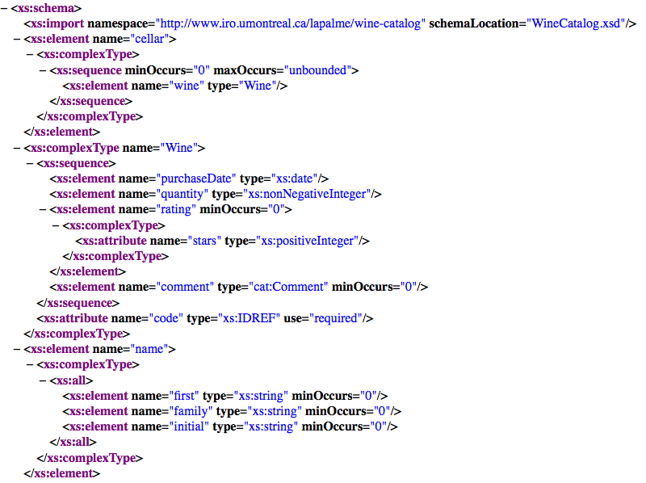
XML Schema
http://www.iro.umontreal.ca/~lapalme/ForestInsteadOfTheTrees/data/CellarBook.xsd
Notes:
Structural metadata describing a web document

Slide 55
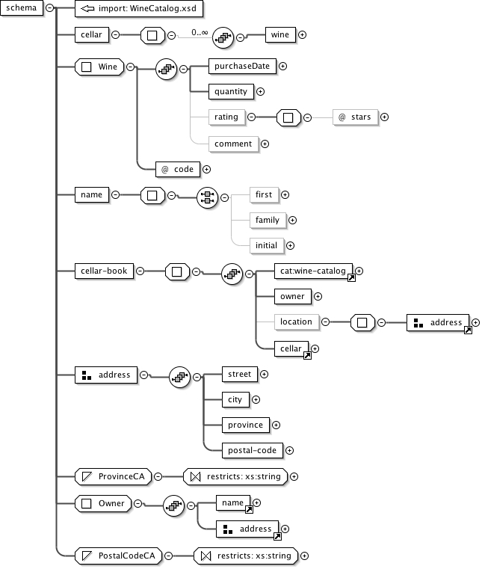
XML Schema
http://www.iro.umontreal.ca/~lapalme/ForestInsteadOfTheTrees/HTML/ch03s02.html
Notes:
Visual representation of same schema, using XML editor software
In a lot of ways, the structural aspect is not that hard to document: software does a lot of it for us, can guide us through creating structural metadata

Slide 56
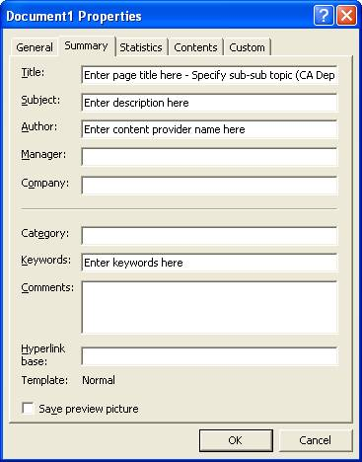
Descriptive Metadata
http://www.cde.ca.gov/re/di/ws/dswebdocmetadata.asp
Notes:
Describing the content can be harder.
Typical document metadata for Word documents. This describes actual content of documents, and this is the kind of metadata we need to collect for the upcoming assignment. Not these specific fields, but at a conceptually similar level: who created these data, where did they come from, what information does the data user need?

Slide 57

Provenance
https://www.flickr.com/photos/58558794@N07/14679186642
Notes:
Descriptive metadata only becomes part of provenance when one also specifies its relationship to deriving an object. For example, a file can have a metadata property that states its size, which is not considered provenance information since it does not relate to how it was created. The same file can have metadata regarding creation date, which would be considered provenance-relevant metadata. So even though a lot of metadata has to do with provenance, both terms are not equivalent. In summary, provenance is often represented as metadata, but not all metadata is necessarily provenance.
Trust is derived from provenance, which is why it’s so important for data that are used for decision-making or regulatory purposes. But it’s important for most research data, which is twhy it’s included in the dataset census fields. That field should be answered with a description of who generated the data, for what purpose, and perhaps if there are other versions of the data.
Example here is provenance for a book in Penn State’s libraries—a bookplate suggests that this volume was previously owned by Vincent Van Gogh.

Slide 58
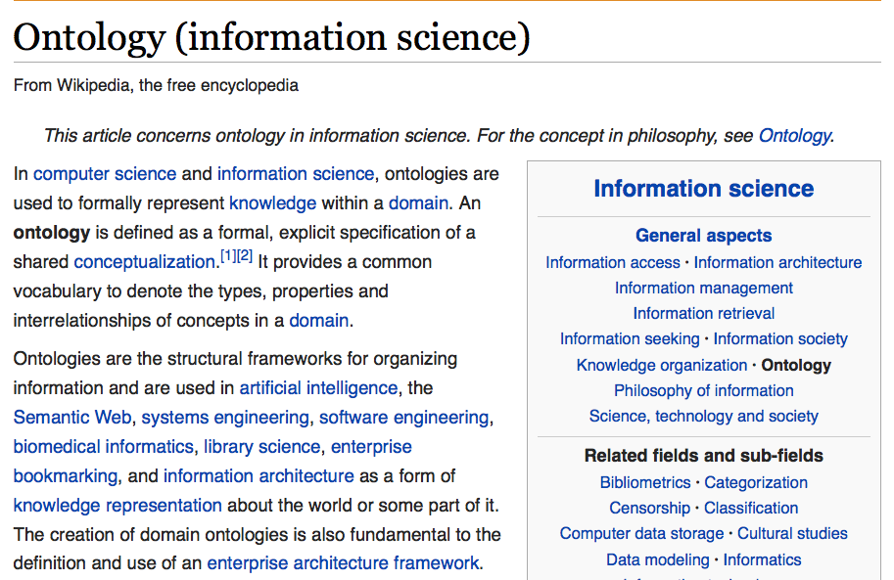
Notes:
Ontology is an explicit specification of a conceptualization. It’s a way of organizing information that powers semantic web and semantic databases. Ontologies add meaning to data relationships, which means that computers can then use machine reasoning for more sophisticated retrieval. They could be considered part of the invisible components of an information architecture because they support search and retrieval.

Slide 59
Attribution
Metadata intro content adapted from:
DataONE Education Module: Metadata. DataONE. Retrieved March 7, 2016. From http://www.dataone.org/sites/all/documents/L07_Metadata.pptx

